Slide 1
Good morning my dear students.

Slide 2
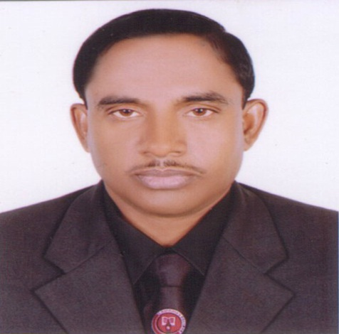
Introduction
Md Hasan Hafizur Rahman
Senior Lecturer
Department of English
Cambrian School & College,Dhaka.
Class 8 English 1st Paper (Writing part)

Slide 3



Slide 4
Let us see what our today’s lesson is. It is a story on-
The golden goose/
The result of greed/
Grasp all, loss all

Slide 5
Learning outcomes
After we have studied this lesson we will be able to-
Listen information
Ask and answer questions
Write a story.

Slide 6
Let us watch a video,

Slide 7
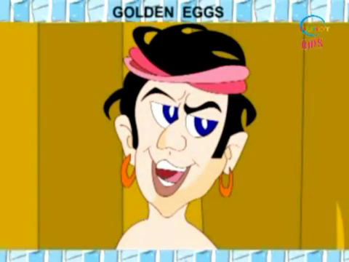
Once there lived a farmer in a village. He had a poultry farm.

Slide 8
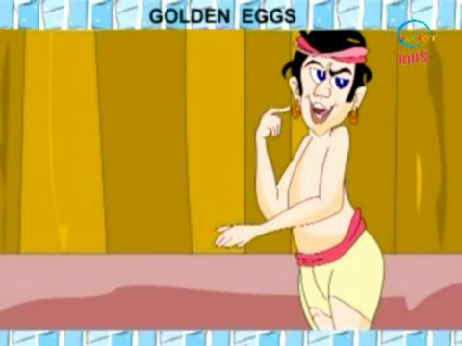
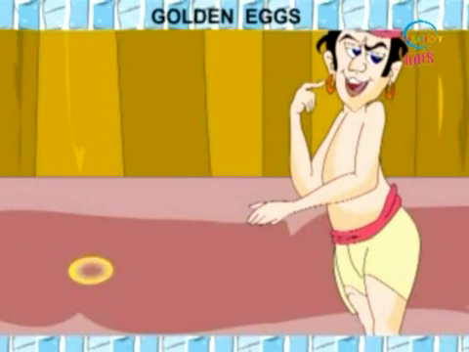
One day while working in his farm, He saw something shining like gold on the ground.

Slide 9
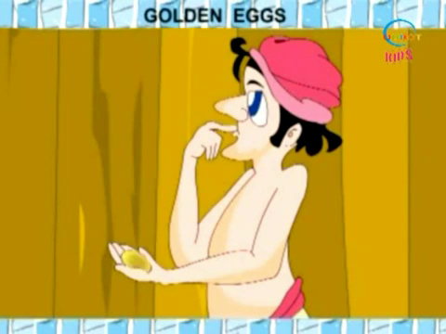
He took it and saw that it was a golden egg. He became surprised to see the golden egg.

Slide 10
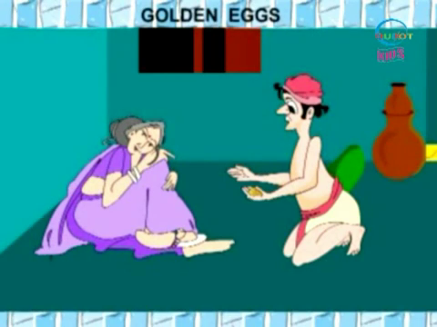
He went home and showed it to his wife. She also became surprised. But she felt happy

Slide 11
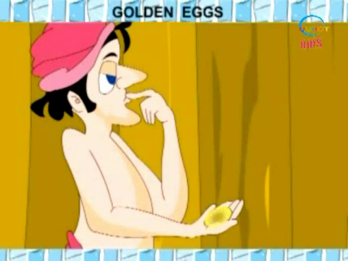
The next day the farmer went into his farm again. He was very curious. He started to look for a golden egg and really he got another one.

Slide 12
“How happy I am.” He cried excitedly.

Slide 13
He showed it to his wife again. His wife was somewhat greedy than the farmer. She thought that they were going to be rich soon.

Slide 14
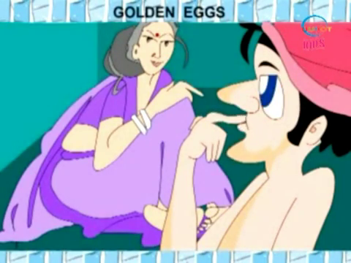
From her greed she thought that there were kilos of gold in its belly. But it was giving only one egg per day. If they killed the goose, they would have got more gold.

Slide 15
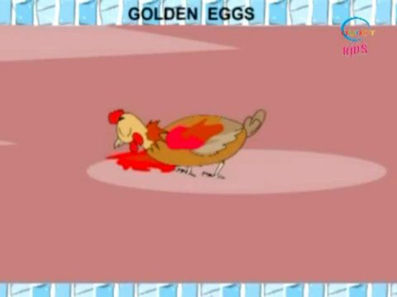
The wife told it to the farmer and they decided to kill the goose. They bought a knife and killed the goose.

Slide 16
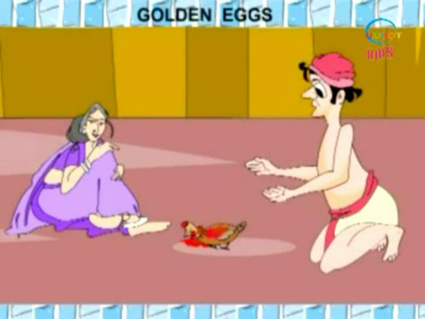
But alas! They found no golden egg or gold. Whereas they lost the golden goose.

Slide 17
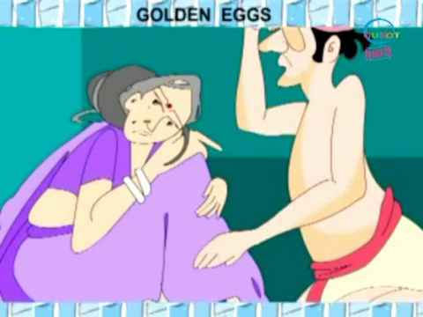
Then they began to mourn as they lost the golden goose and their golden future.

Slide 18
Group Work

Slide 19
Evaluation
Answer the following questions:
What was the story about?
Where did the farmer get the golden egg?
What did the farmer do with the golden egg?
What did they want after having the golden egg?
Why did they kill the goose?
What happened at last?

Slide 20
Home Work
Write a story on
‘The result of greed.”

Slide 21
Verse Universal
All covet, all lost

Slide 22
Thank U

